Slide 1
Chapter 8: Sorting

Slide 2
Introduction
Sorting is the process of sequencing or arranging a list of data items (char, int, structure) according to some order.
The main purpose of sorting is to improve the search or access time.
Without sorting, it will take a longer time to access information in a large database.

Slide 3
Type of Sort
Selection Sort
Insertion Sort
Bubble Sort
Quick Sort
Merge Sort
2

Slide 4
Selection Sort
The selection sort algorithm sorts a list by selecting the smallest element in the unsorted list and then moving this smallest element to the beginning of the list.
First, locate the smallest element in the entire list and place it in the first position of the list.
Then, locate the smallest element in the list starting from the second element and place it in the second position.
This will go on until entire array is sorted.
2

Slide 5
Exercise
Show the process of sorting by using the selection sort:
  21, 45, 12, 65, 34

Slide 6

Selection Sort Algorithm
Given an array A with n elements:
  1. Find the smallest of A[0], A[1],…..A[n-1] and swap that number (assume in location A [smallest]) with the number in position A[0]. Now A[0] will have the smallest number.
  2. Find the position of the smallest value in the rest of the list, i.e, A[1],A[2]….A[n-1], and swap that number with the number in position A[1].
  3. Continue the process until the smallest of A[n-1] and A[n-2] is swapped into position A[n-2].This complete the sort.

Slide 7
Insertion Sort
The insertion sort algorithm sorts the list by moving each element to its proper place.
An insertion sorts starts by considering the two first elements of the array data which are data[0] and data[1].
If they are out of order, an interchange takes place.

Slide 8
Insertion Sort
Then the third element, data[2], is considered and inserted into its proper place.
If data[2] is less than data[1] and data[0], these two elements are shifted by one position;data[1] at position 3, data[0] at position 2 and data[2] at position 1.

Slide 9
Insertion Sort
If data[2] is less than data[1]and not less than data[0], then only data[1] is moved to position 3 and its place is taken by data[2].
If data[2] is not less than its previous list, it stay in its current position.
This will go on with the rest of data until the whole array is sorted.
2

Slide 10
Exercise
Show the process of sorting by using the insertion sort:
  21, 45, 12, 65, 34

Slide 11
Bubble Sort
In bubble sort, adjacent elements are compared and rearranged as necessary until whole list is completely ordered.
Each pass will shift the smaller element to the beginning of the list.
Each large element “bubbles” to the top while the smaller elements “sink” to the bottom.
2

Slide 12

Bubble Sort Algorithm
Given an array A with n elements:
  1. Compare A[0] and A[1] and arrange them in order such that A[0]<A[1]. Then compare A[1] with A[2] and rearrange them so that A[1]<A[2]. Continue the process until compare A[n-2] with A [n-1] and rearrange them so that A[n-2]<A[n-1]. This will cause the largest element to occupy A[n-1].

Slide 13
Bubble Sort Algorithm
  2. Repeat step 1 with one less comparison, repeat step 1 against the list from A[0] to A[n-2]. At the end of step 2, the second largest element will occupy A[n-2].
  3. Repeat step 1 with two fewer comparison, repeat step 1 against the list from a[0] to a[n-3]. At the end of step 3, the third largest element will occupy A[n-3].
  4. Continue step 1 until element A[0] and A[1]. Compare A[0] with A[1] and arrange so that A[0]<A[1]. This ends the sort.

Slide 14
Exercise
Show the process of sorting by using the Bubble sort:
  32, 14, 76, 33, 16

Slide 15
Quick Sort
Selection, Insertion and Bubble sort are not very efficient for large arrays or list.
Quick sort, Merge sort and Heap sort are more efficient techniques to sort large list.
Quick sort is currently the most efficient and widely used sorting technique.

Slide 16
Quick Sort
The array or list is partitioned into two parts and an element is chosen as a pivot key.
One part contains elements that are smaller than the pivot (lowerSublist).
The other part contains elements that are greater than the pivot (upperSublist).
Pivot is chosen so that, it is hope, both of the parts are nearly equal size.
Each of the two parts is recursively sorted until the whole array gets sorted.

Slide 17
Exercise
Show the process of sorting by using the Quick sort:
  19, 12, 8, 22, 18, 23

Slide 18
Quick Sort General Algorithm
1.While first<last.
  1.1 Partition the list into two sublists, say lowerSublist and upperSublist.
  1.2 Quick sort lowerSublist.
  1.3 Quick sort upperSublist.

Slide 19
Quick Sort Partition Algorithm
1. Choose a pivot element. Index smallIndex is initialized to the first element of the list.
2. For the remaining elements in the list (starting at the second element): If the current element is less than pivot
  Increment smallIndex.
  Swap the current element with the array element pointed to by smallIndex.
3. Swap the first element (pivot) with the array element pointed to by smallIndex.
4. Return smallIndex.

Slide 20
Exercise
Show the process of sorting by using the Quick sort:
  29, 22, 18, 32, 28, 33

Slide 21
Merge Sort
Merge sort uses the divide-and-conquer technique to sort a list
It partitions the list into two sublists, and then combines the sorted sublists into one sorted list
It partitions the list into nearly equal sizes
For example, consider the list:
  List: 35 28 18 45 62 48 30 38
Merge sort partitions this list into two sublists as follows
  first sublist: 35 28 18 45
  second sublist: 62 48 30 38

Slide 22
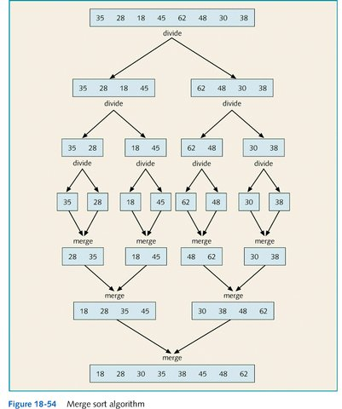

Slide 23
Merge Sort Algorithm
1. Partition the input list into two halves.
2. Repeat step 1 until the sublist sequence has fewer than two elements. 3. Recursively sort each of the smaller sublist. Single sublist are always sorted.

Slide 24
Merge Sort Algorithm
4. Merge (combine) the two sorted sublist to form the output list.
5. Repeat step 4 for other sorted sublist and work back up the recursion by merging together the sorter list into larger ones until the entire list gets sorted.

Slide 25
Exercise
Show the process of sorting by using the Merge sort:
  32, 14, 76, 33, 16, 5

Slide 26
Exercise
Show the process of sorting by using the Merge sort:
  54, 4, 26, 66, 13

